Slide 1

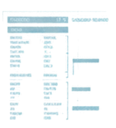

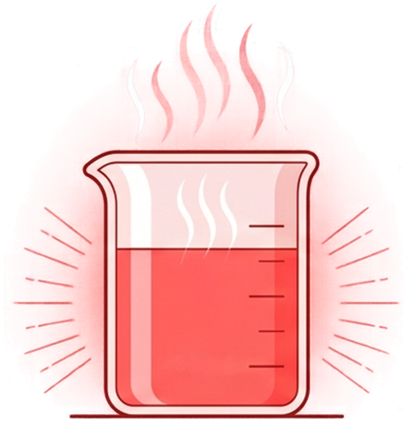

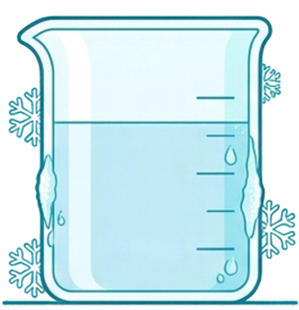












Ch1 LG P.33-35
S1
Dissolving salt with water of different temperatures
100mL
100mL
25°C
COLD WATER
HOT WATER
80°C
COLD WATER
ENVIRONMENT
ENVIRONMENT
HOT WATER
TEMPERATURE:
25°C
TEMPERATURE:
80°C
STATE:
COLD
STATE:
HOT
VARIABLE
VARIABLE
WATER VOLUME:
100mL
WATER VOLUME:
100mL

Slide 2






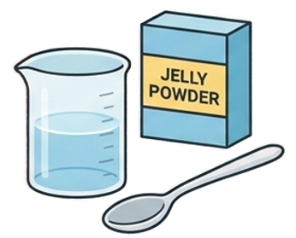
Q12 (a) What is the problem to be investigated?
Whether hot water dissolves more salt than cold water.
Find the “W” word
Identifying the problem is the first step of any scientific investigation.
Always look for the ‘W’ word (Whether, Which, What).

Slide 3



Q12 (b) What is your hypothesis?
Hypothesis [noun]: A testable, reasonable prediction to our core problem.
Hot water will dissolve salt faster than using cold water.
A hypothesis isn't just a blind guess; it is a specific statement that our upcoming experiment will either prove or disprove based on measurable data.

Slide 4


Slide 5
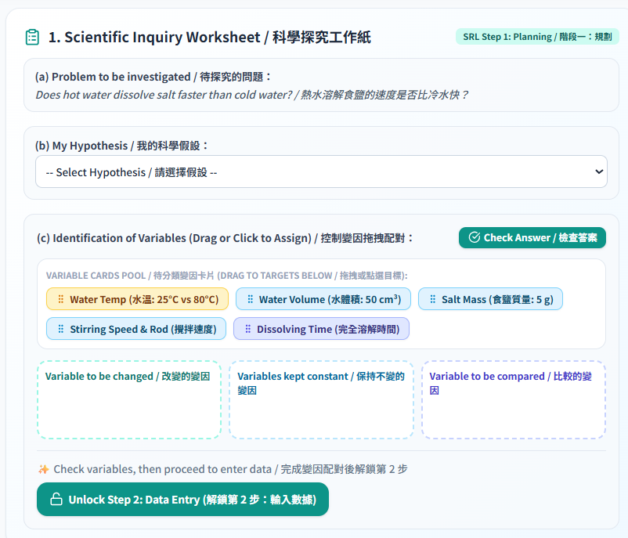
Task 1

Slide 6
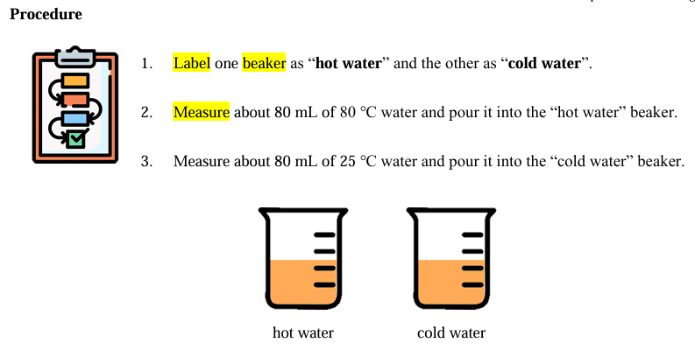

Slide 7
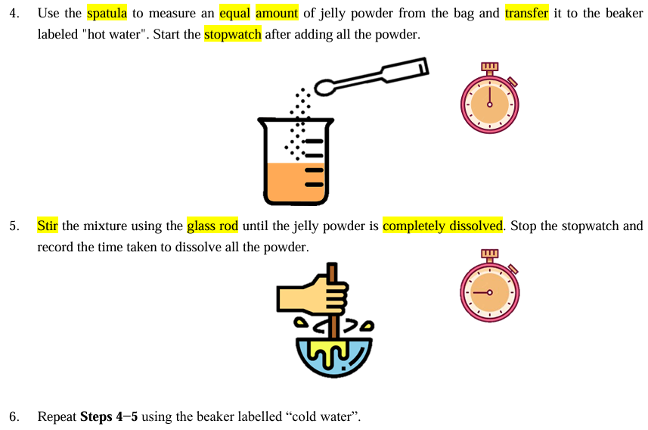

Slide 8
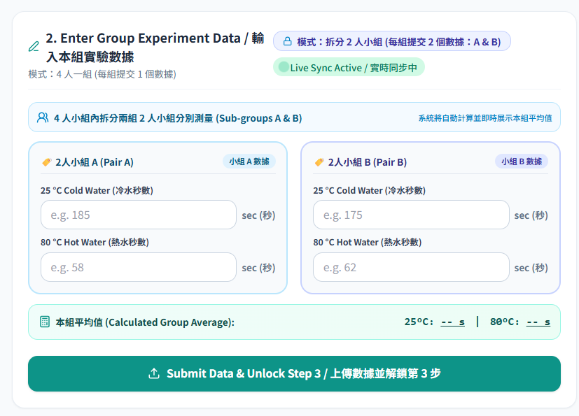
Task 2

Slide 9
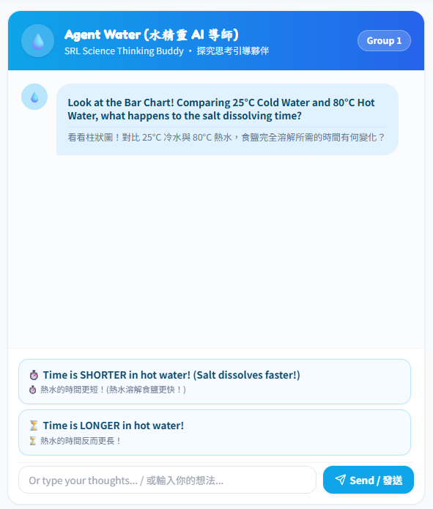
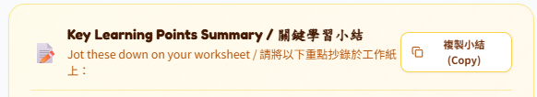
Task 3
Task 4
Mark down 1-2 key point(s) in your notebook

Slide 10
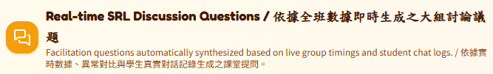

Slide 11
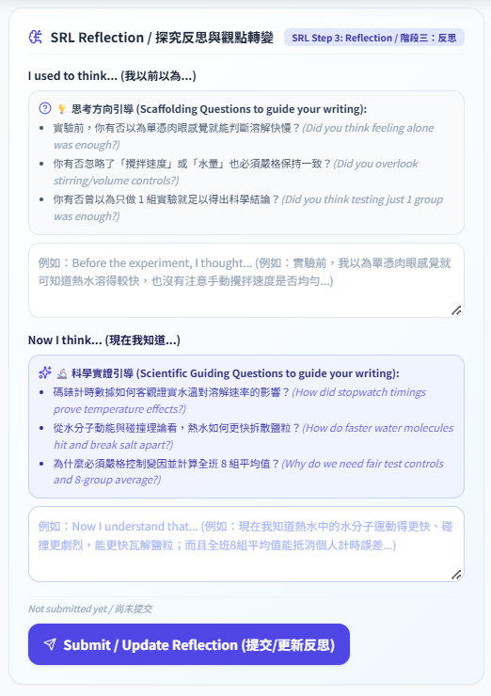
Task 5
Write down and submit your reflections of today’s lesson.

